Slide 1
What is Computational Thinking?
Notes:
* Please sit at the front

Slide 2
CoTaPP: Computational Thinking and Programming with Python
Module 1: Computational Thinking
8 February 2023

Slide 3

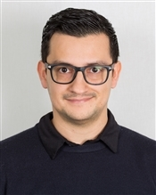

Teaching Staff
Plus seminar assistants
Notes:
Who I am
When the break will be

Slide 4

Where are we starting?
Notes:
Show the first 5 Wooclap questions (up to “What is your degree programme?”)

Slide 5
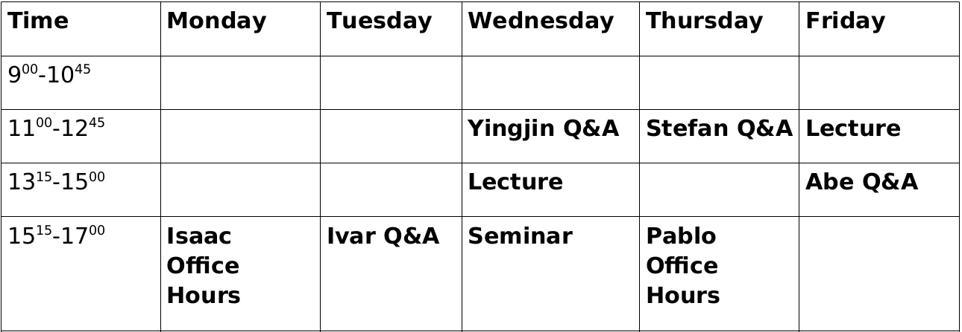
Course Administration
Notes:
* Info in course manual (Blackboard)
* MyTimetable for room changes
* I’m not holding office hours tomorrow
* Eduardo can be met by appointment only
* Four projects: deadlines on manual, group assignment to be communicated soon
* Two exams: dates on manual and on MyTimetable

Slide 6

Suggested Work Plan
Read lecture notes before class
Ask questions during lecture
Practice on StudyLens
Do exercises on Quarterfall
Notes:
* This is also mentioned on the course manual
* StudyLens details to follow

Slide 7
Lecture Format
Interactive presentation
Jupyter notebooks
Ask questions!
No recordings

Slide 8
What is
Computational Thinking?

Slide 9
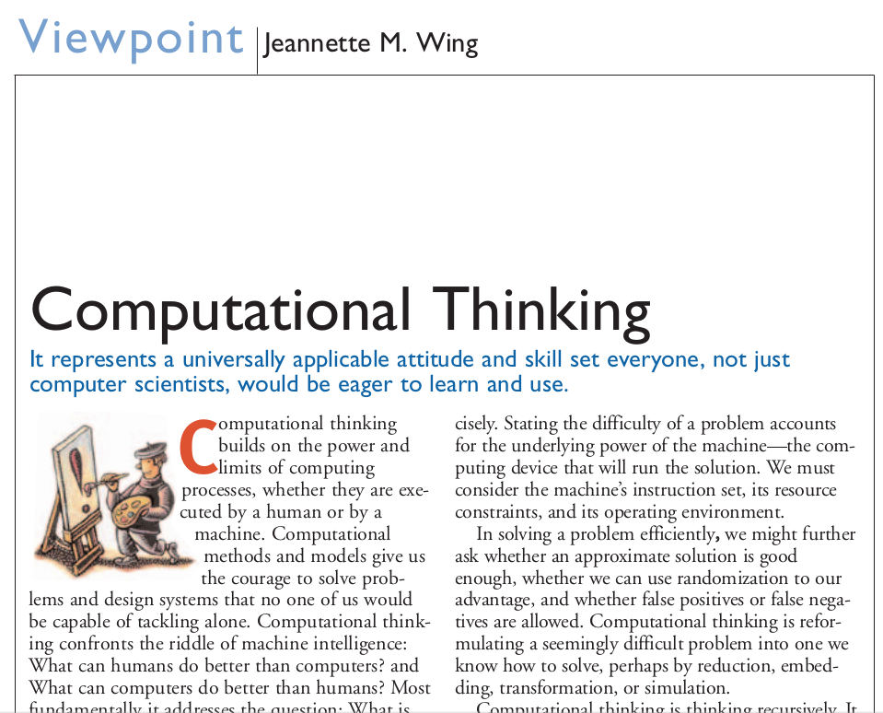
Module 1:
Computational Thinking

Slide 10
Module 1:
Computational Thinking
What is it?
Notes:
* Write answers on blackboard
* Some examples I’m looking for:
Figuring out how to get a computer to do a job for us
Learning how the world works
Advising us about jobs that computers cannot do in any reasonable amount of time

Slide 11
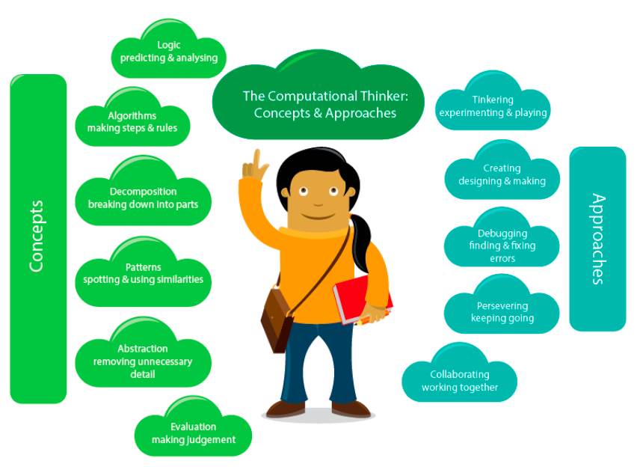
Module 1:
Computational Thinking
Notes:
* Say I got this diagram from INFOB1CODE
* Go through some of the bubbles and relate them to what is on the blackboard
* Ask them what is wrong with this presentation

Slide 12
Module 1:
Computational Thinking
A. Csizmadia et al., "Computational thinking-A guide for teachers," 2015.
Notes:
* Say I got this diagram from INFOB1CODE
* Go through some of the bubbles and relate them to what is on the blackboard
* Ask them what is wrong with this presentation

Slide 13
Giving Instructions
Take a piece of paper and a pen.
Draw a dot in the center of the page.
Draw a rectangle around the dot.
Write your name under the rectangle.
Notes:
* Think Pair Share

Slide 14
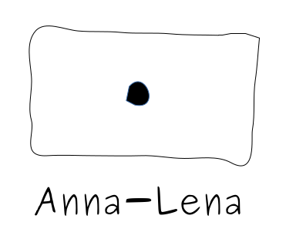
Giving Instructions
Take a piece of paper and a pen.
Draw a dot in the center of the page.
Draw a rectangle around the dot.
Write your name under the rectangle.
Pablo

Slide 15
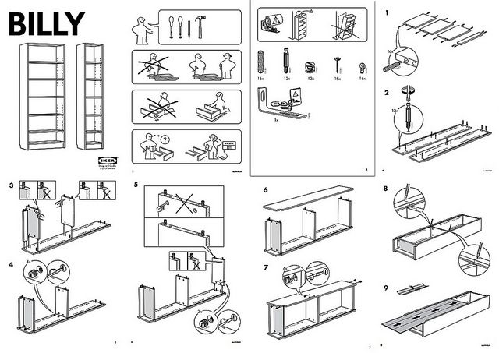
Giving Instructions
https://cdn.frankwatching.com/app/uploads/2016/09/instructions_IKEA_billy-295x209.jpg
Notes:
* computational thinking need not be about computers or mathematics at all. For example, splitting up the instructions to build a bookcase into consecutive steps that must be carried out one at a time and that are defined very precisely → that’s computational thinking

Slide 16
Giving Instructions
Take a piece of paper and a pen.
Draw two dots close to each other.
Draw a short line.
Draw a U-shape.
Draw a circle around everything.
Notes:
* Think Pair Share

Slide 17
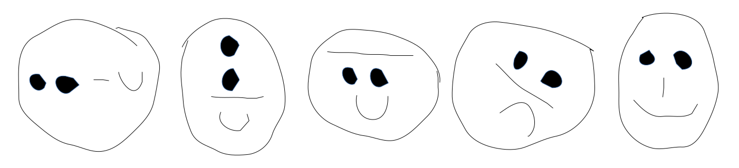
Giving Instructions
Take a piece of paper and a pen.
Draw two dots close to each other.
Draw a short line.
Draw a U-shape.
Draw a circle around everything.
Notes:
* Stress the importance of good instructions

Slide 18

Giving Instructions

Slide 19
Giving Instructions
1. forward(x)
2. left(x)
3. right(x)
4. jump(x,y)
Notes:
* Write the repertoire of instructions on the blackboard

Slide 20
Giving Instructions
forward(100)
jump(0,0)
left(45)
forward(100)
jump(0,0)
left(45)
forward(100)
jump(0,0)
left(45)
forward(100)
jump(0,0)
left(45)
forward(100)

Slide 21
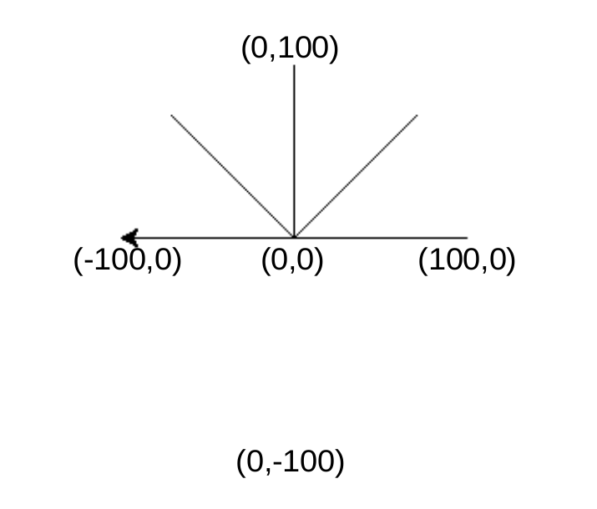
Giving Instructions
forward(100)
jump(0,0)
left(45)
forward(100)
jump(0,0)
left(45)
forward(100)
jump(0,0)
left(45)
forward(100)
jump(0,0)
left(45)
forward(100)

Slide 22
Giving Instructions
(0,10)
(10,10)
(0,0)
(10,0)
Notes:
* Come up with the instructions

Slide 23
Giving Instructions
(0,10)
(10,10)
forward(10)
left(90)
forward(10)
left(90)
forward(10)
left(90)
forward(10)
(0,0)
(10,0)

Slide 24
Giving Instructions
(0,0)
Notes:
* Think Pair Share: 2 minutes
* Say that what we’ve done so far is essentially programming
* But the Turtle-graphics programming language is not powerful enough for this problem
* It’s as if Ikea told you to jump over the bookcase to continue building → you just can’t do it

Slide 25
Computational Thinking Bingo
Notes:
* Read out words and have them write them down
instructions
thinking
forward
computational
draw
left
giving
jump
programming
example
lecture
take
paper
right
language, characters, turtle, graphics

Slide 26
What’s next?
Seminar right after this lecture

Slide 27
What’s next?
Seminar right after this lecture
Submit exercises on Quarterfall

Slide 28
What’s next?
Seminar right after this lecture
Submit exercises on Quarterfall
Read lecture notes for next lecture on Blackboard

Slide 29
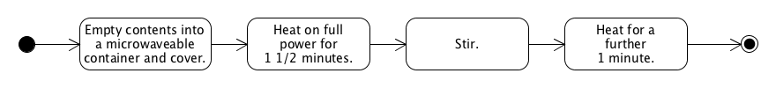
Next class
Activity Diagrams

